Slide 1
JAGUAR
My Animal Project
By GianLuca Broce

Slide 2
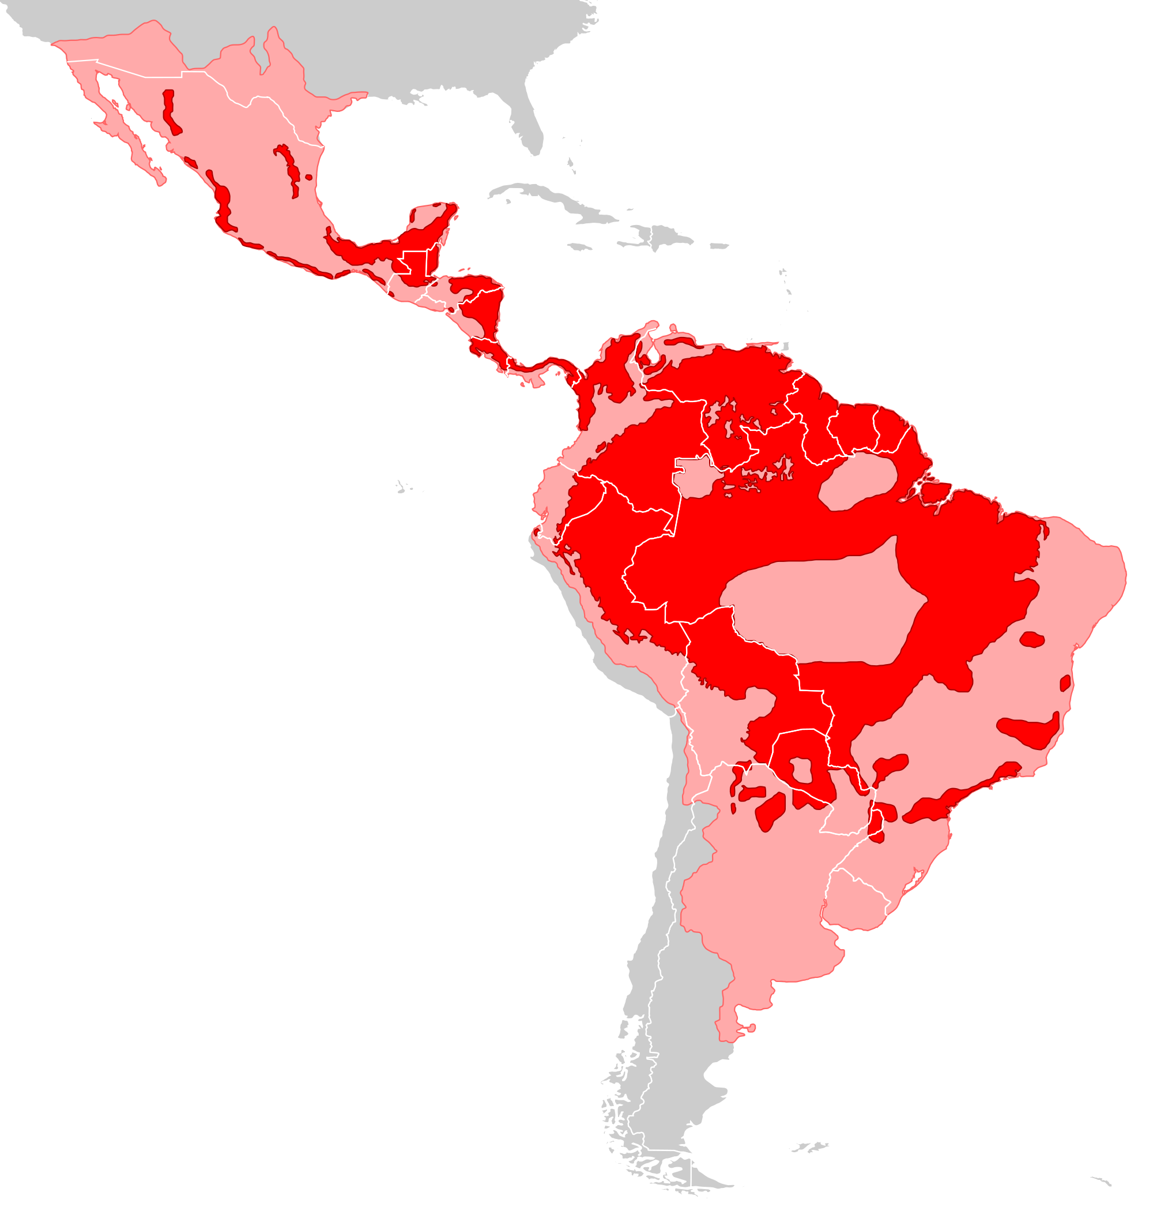
Jaguar: Biggest cat in America
Jaguars can be identified by their yellow and orange coats, dark spots and short legs. Each spot looks like a rose and are called rosettes. They can be found in North, Central and South America.

Slide 3
Classification
Scientific name: Felis onca
Class: Mammalia
Order: Carnivora
Family: Felidae
Species: Panthera onca

Slide 4
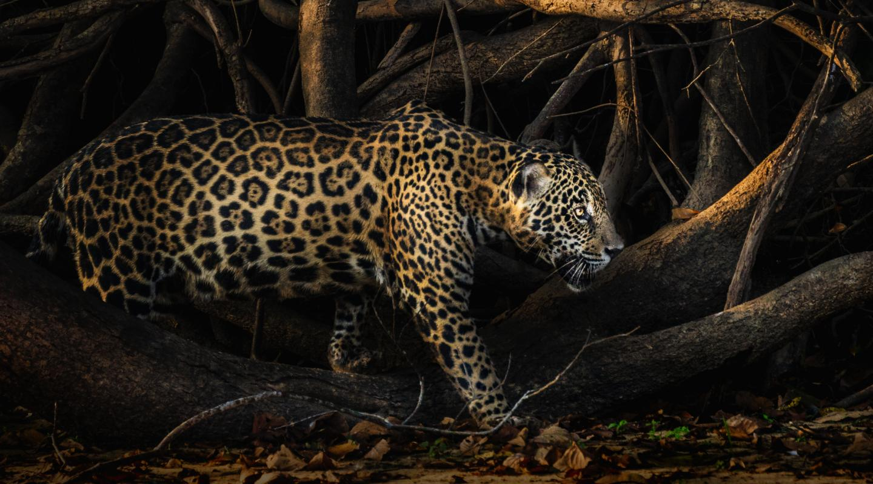
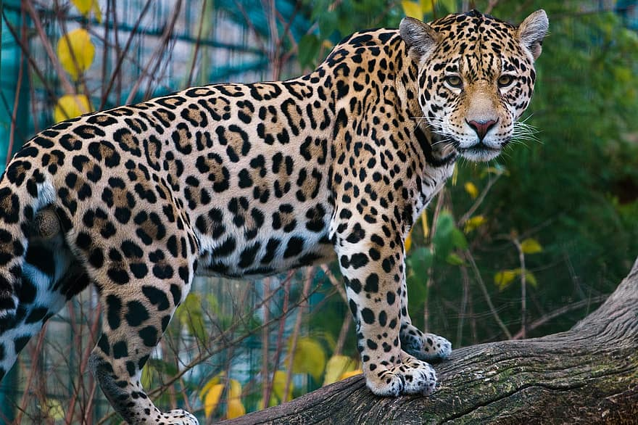
Habitat
Jaguars live in deep tropical forests, or woods. They tend to stay close to water and they like to fish.

Slide 5
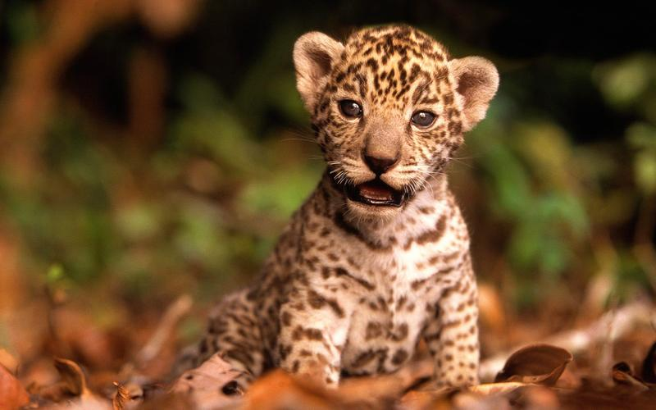
Babies names
Jaguar babies are called cubs. After six months, the cubs' mother will teach them how to hunt, and after their second birthday, the cub will leave their mother to live on their own.

Slide 6
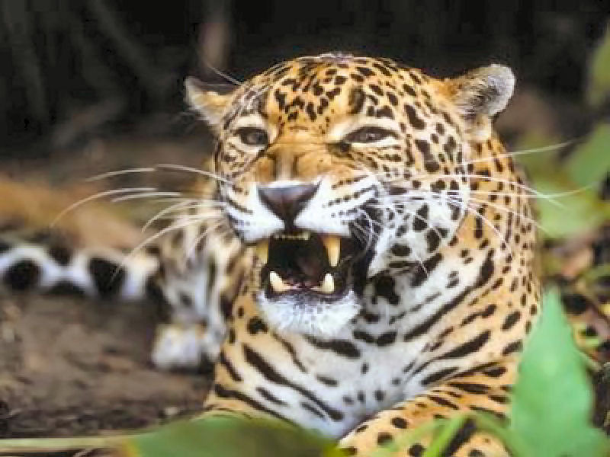
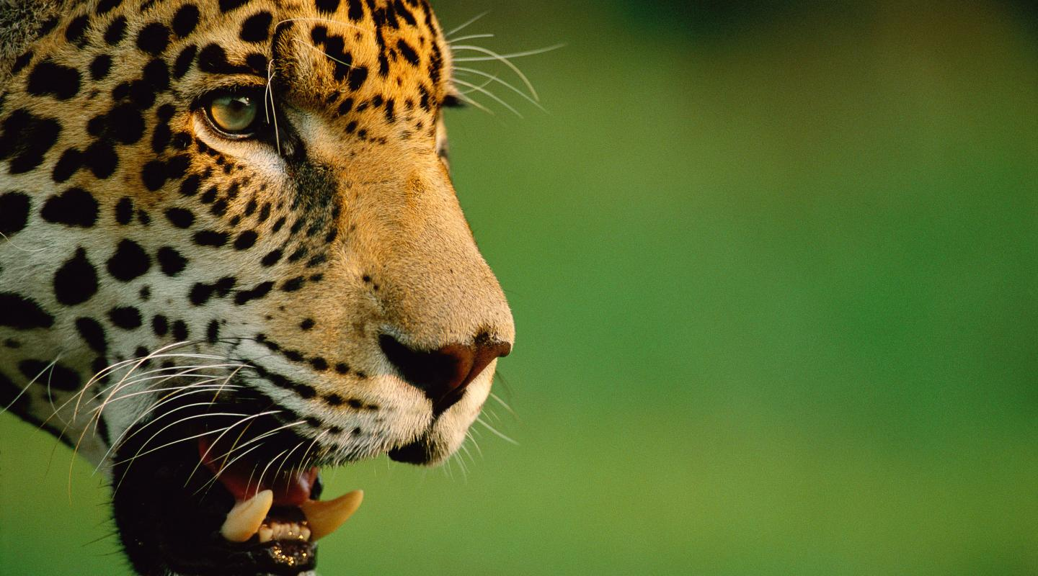
Protection
To keep other jaguars at bay, they mark their territory with urine or by marking trees with their claws.
The jaguar is a top-level predator, it doesn’t have any natural predators other than humans.
During a hunt, jaguars take advantage of their strong jaws and sharp teeth.

Slide 7
Fun Facts
Their name comes from the Native American word "yajuar." Yajuar means "he who kills with one leap."
Jaguars can see six times better than humans at night.
Unlike most cats, jaguars are not afraid of water. They are also very good swimmers.

Slide 8
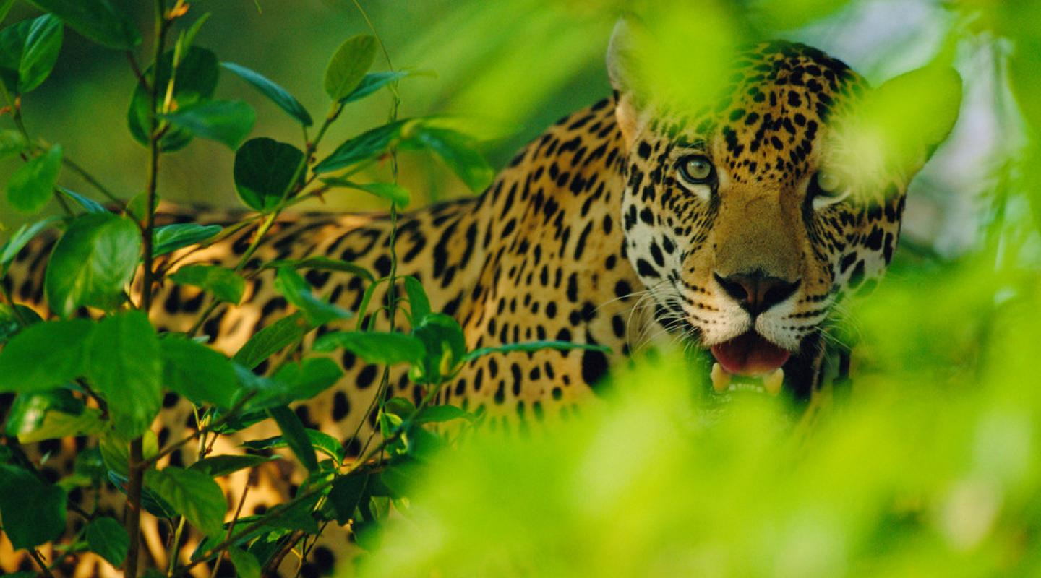
THANK YOU

